Slide 1

Last Mile Security Changes
Marcus Greuel, 20.04.2023

Slide 2


Last Mile Security Legacy way
Application
Iris
M2M Identity Management
Application
- clientId
- clientSecret
1
Application
- clientId
- clientSecret
Iris
Access Token
2
Authorization Header
TARDIS Service
Iris
Acccess Token
3
Last-Mile-Security Token
4
Common Developer Portal
One Stop Shop for Developers https://developer.telekom.de/
X-Gateway-Token Header
Request access-token from Iris
by clientId and clientSecret
Cache Iris-access-token in application
1
Call endpoint of TARDIS passing
Iris-Access-Token in Authorization Header
2
TARDIS calls the Application by passing
Iris-Access-Token and LMS Token
3
4

Slide 3
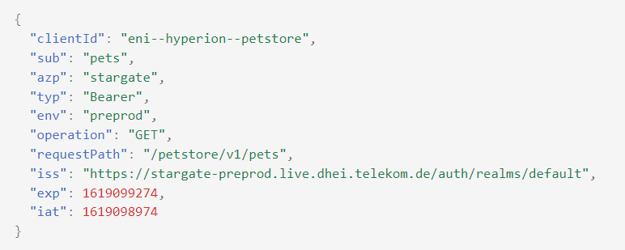
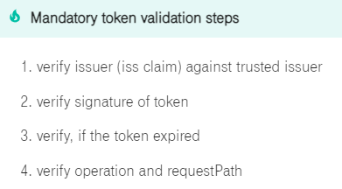
Last Mile Security Mandatory way
Application
Iris
M2M Identity Management
Application
- clientId
- clientSecret
1
Application
- clientId
- clientSecret
Iris
Access Token
2
TARDIS Service
3
Last-Mile-Security Token
4
Common Developer Portal
One Stop Shop for Developers https://developer.telekom.de/
Authorization Header
Request access-token from Iris
by clientId and clientSecret
Cache Iris-access-token in application
1
Call endpoint of TARDIS passing
Iris-Access-Token in Authorization Header
2
TARDIS calls the Application by passing
LMS Token
3
4

Slide 4
Last Mile Security Changes
Rover
The default for the „accessTokenForwarding“ flag in an exposure will change to false
After new processing by rover-ctl the behaviour will change
If you need the legacy way, you have to set „accessTokenForwarding=true“ in your exposure
Change of the Default
19.04.2023 Playground is live
03.05.2023 av, bond, cit2, cit4, frv, rv, sit
31.05.2023 PreProd
21.06.2023 Production
Demand by Security:
All applications must use the new default LMS Token
Latest 31.12.2023
Will be topic in the PSA

